Slide 1

Vehicle Service & Maintenance Management System
Theme-SDG Goal 9 (Industry Innovation & Infrastructure)
Category- Software
Group No -18
GroupMembers- pravin sahu, omkar salvi, smit rane, jay patil
Guide-Prof. Susmita Madineni

Slide 2
Outline
Introduction
Literature Survey
Limitations of Existing Systems
Problem Statement
Proposed Methodology
Experimental Setup
Implementation
Results
Refrence
Future Scope

Slide 3
Introduction
Background & Importance
Manual service record management is difficult
Hard to track service history
Need for digital maintenance tracking system
Increasing number of vehicles

Slide 4
Literature Survey
Existing garage systems use manual registers
Some digital apps store service records
Limited customer access available
No centralized maintenance tracking

Slide 5
Problem statement and Objectives
Problem Statements:
Manual service record management is inefficient
Lack of digital storage system
No transparency for customers
Hard to track maintenance cost
Objectives:
Create a digital service management system
Provide owner and customer login
Store vehicle & service details
Generate maintenance invoices

Slide 6
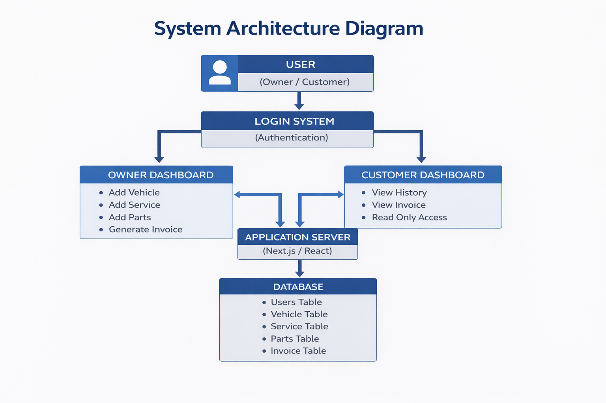
Proposed Methodology

Slide 7
Experimental Setup
Software Use
TypeScript
React.js
Next.js
Node.js

Slide 8
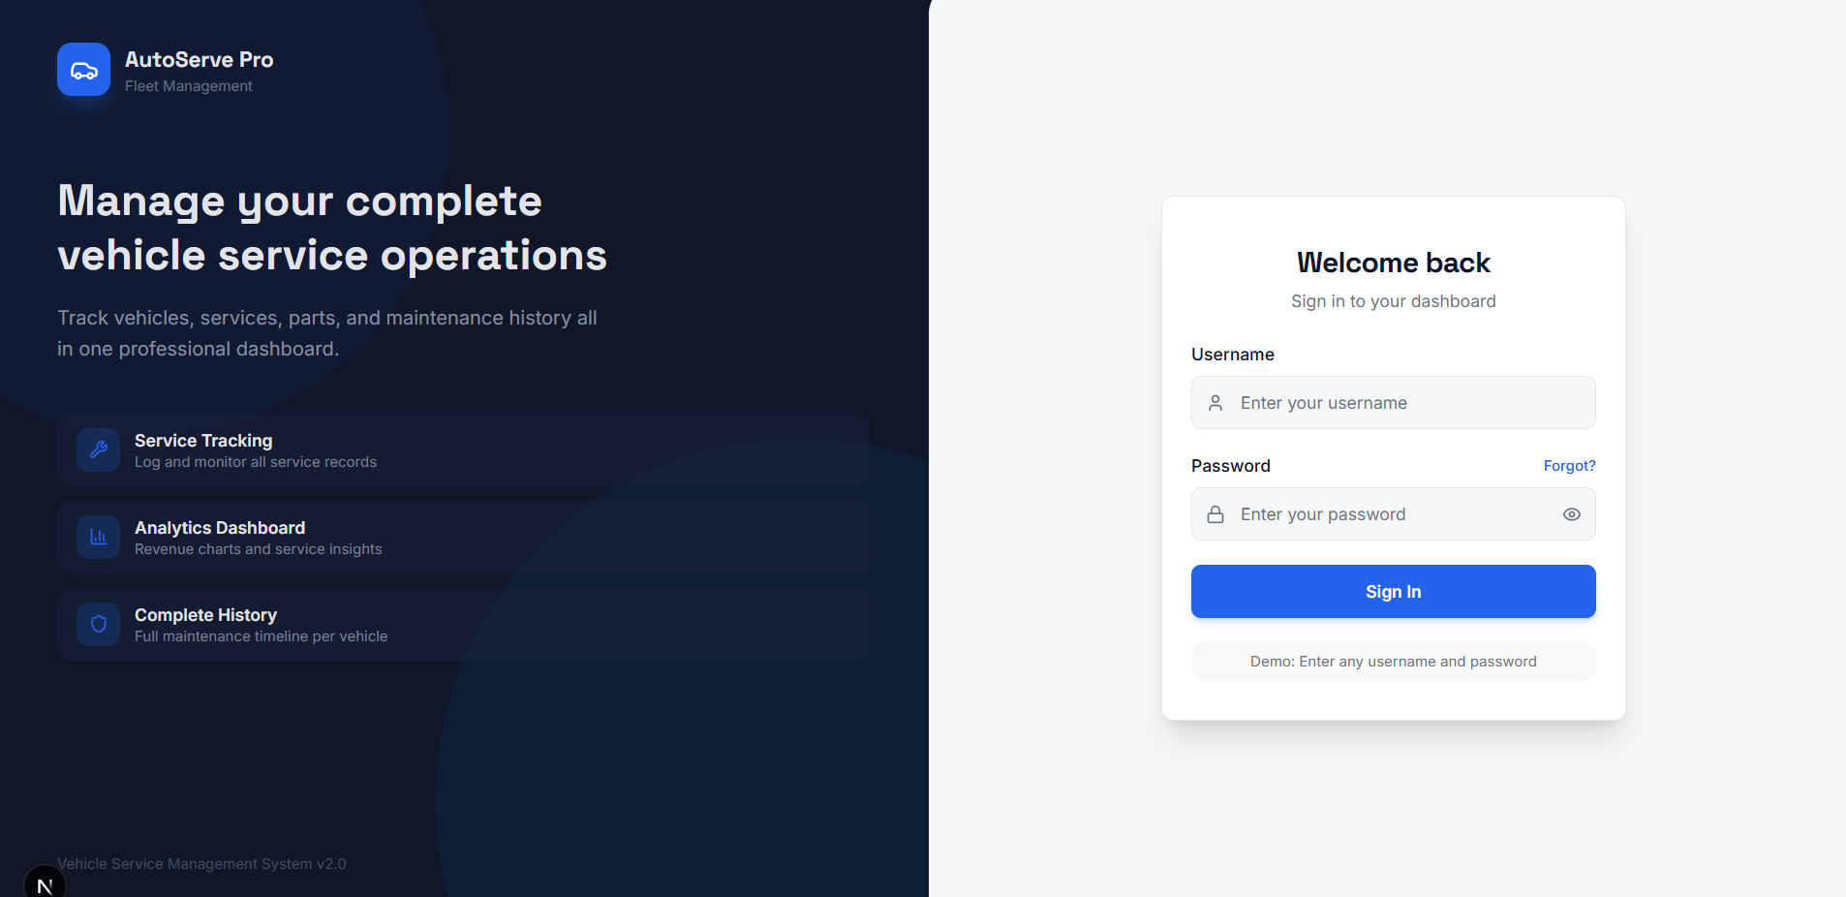
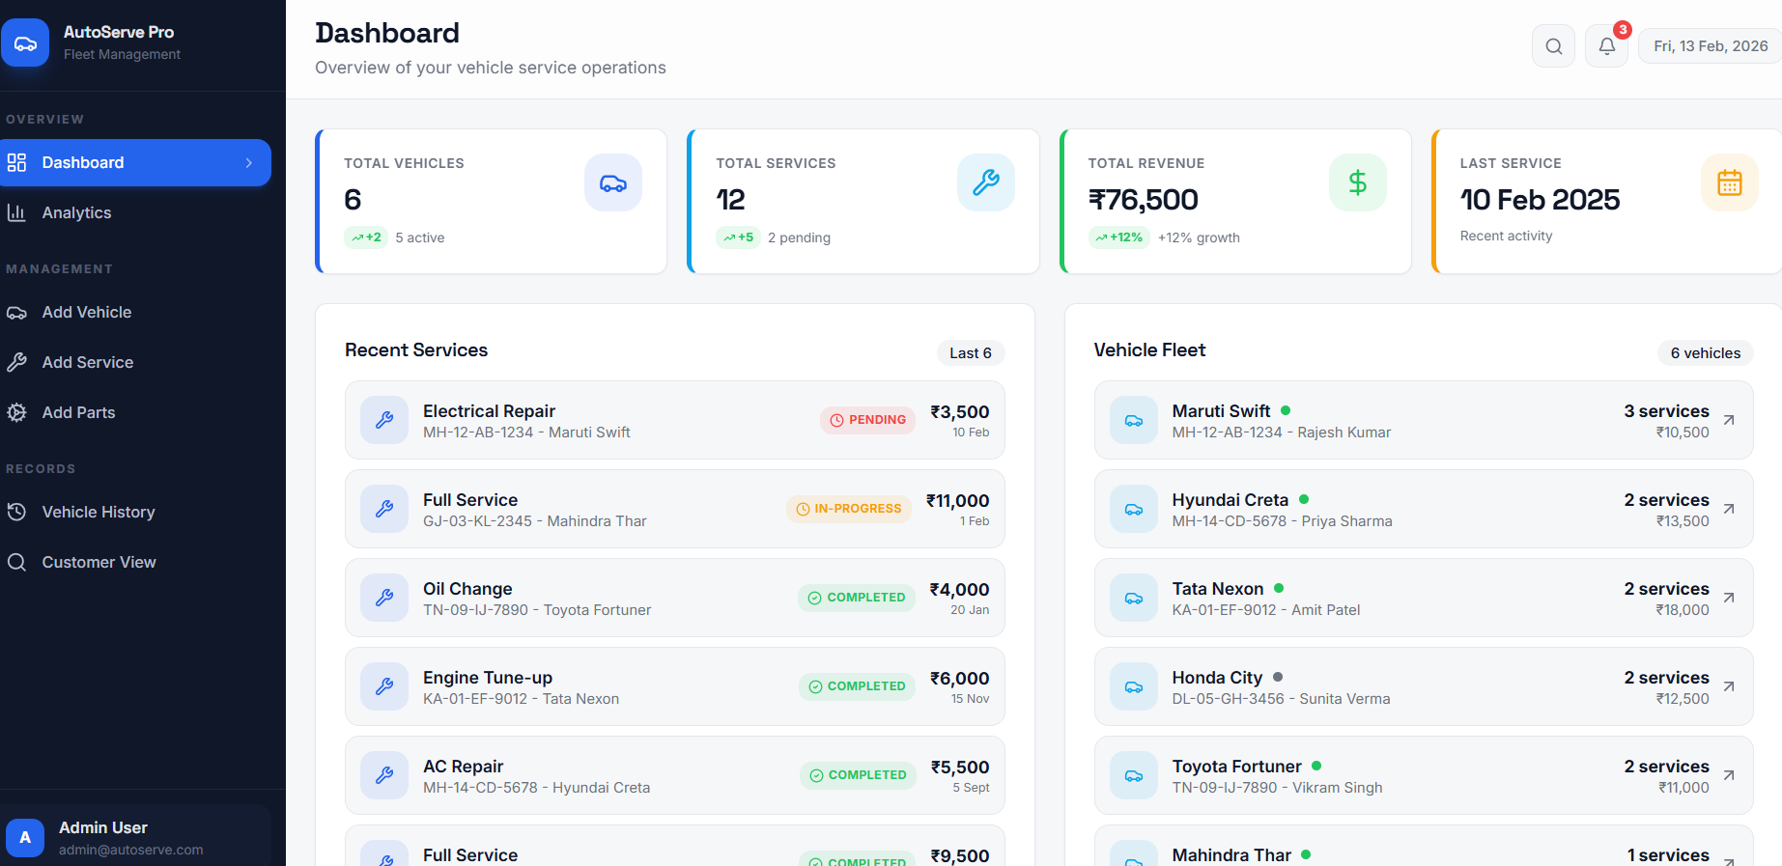
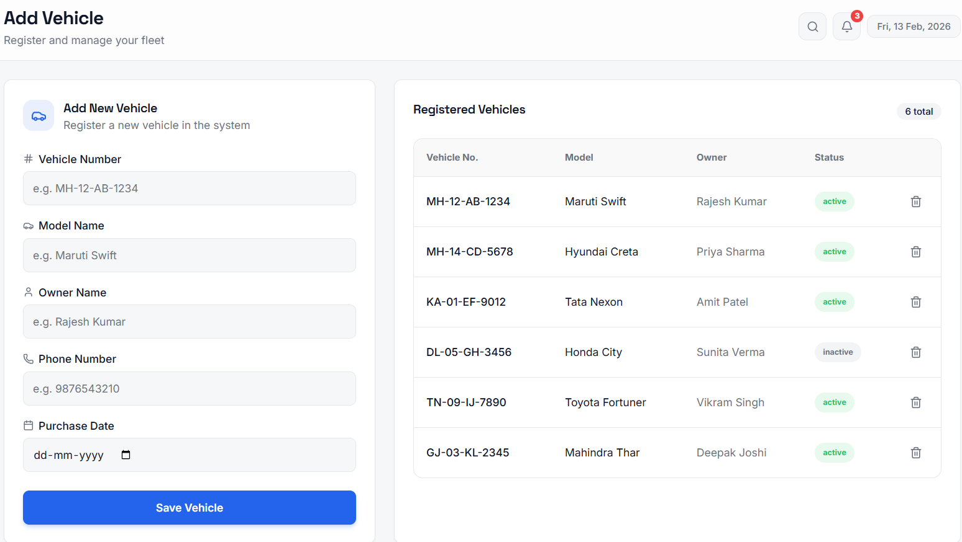
Implementation

Slide 9
Results & Analysis
Fast data access
Easy service tracking
Secure record storage
Reduced paperwork
Improved management efficiency

Slide 10
Conclusion
System successfully stores vehicle records
Improves service management
Provides transparency to customers
Easy to maintain and use
Future Work
Mobile app version
SMS service reminders
Online payment integration
Conclusion and Future work

Slide 11
References
React.js Documentation
Next.js Documentation
Node.js Official Docs

Slide 12
Thank You...!!

